Slide 1
Final Project of Data Science

Slide 2
Introduction / Problem Description
Every business, big or small is a vision backed by hard work, determination and aspirations.
A drive to take an idea from its inception to fruition.
Therefore, it becomes all the more necessary that one's blood and sweat don't go in vain.
To achieve the goal we need to analyze the local geographical data via Foursquare and recommends restaurant type
Take one's neighborhood preference for a better shot at success
The analysis creates a list of top 10 spots of Restaurant in every neighourhood

Slide 3
Introduction / Problem Description
Top 10 spots displayed against percentages of the total restaurants in that particular neighborhood
The client can use this analysis to see which cuisine based restaurants are lacking or what type of Restaurants are doing well (due to their high number) in each neighborhoods

Slide 4
Data
The analysis is done using the New York Data
The foursquare API data to identify the venues in neighbourhoods.

Slide 5
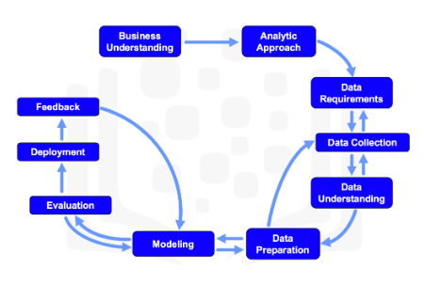
Methodology

Slide 6
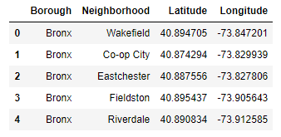
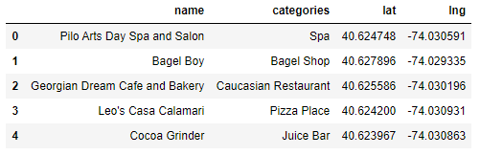
Download and prepare the data
Neighborhood has a total of 5 boroughs and 306 neighborhoods, all are extracted.
Transform the Data into Pandas Data Frame.
Segment the Neighborhoods of all 5 Boroughs.
Define Foursquare credentials and version.
Explore ‘Venues’ near every Neighborhood

Slide 7
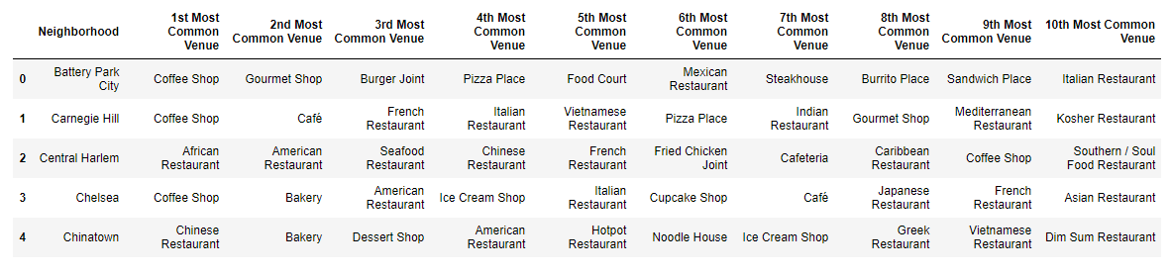
Analyse each Areas
Group rows by neighborhood and by taking the mean of the frequency of occurrence of each category.
Print the top 5 most common venues/neighborhoods

Slide 8
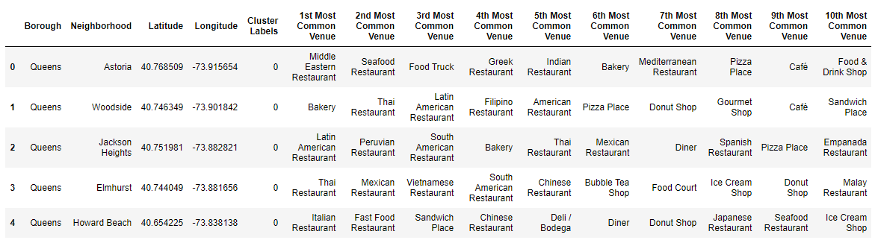
Cluster the results
K-Means can group data only unsupervised based on the similarity of customers to each other.

Slide 9
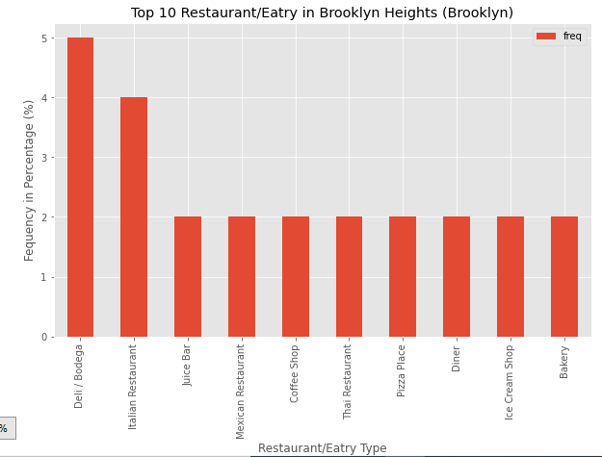
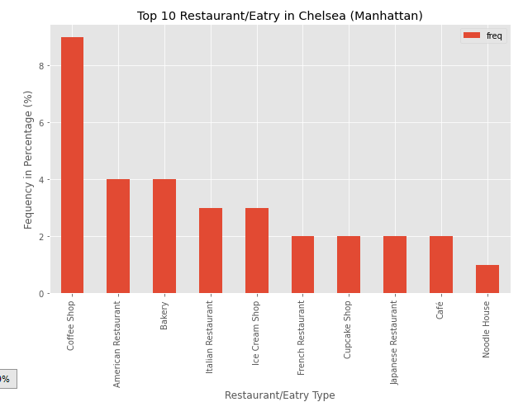
Results

Slide 10
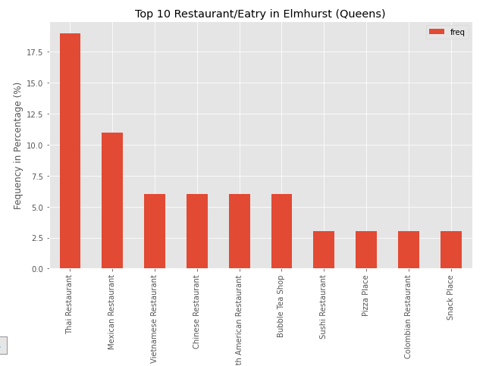
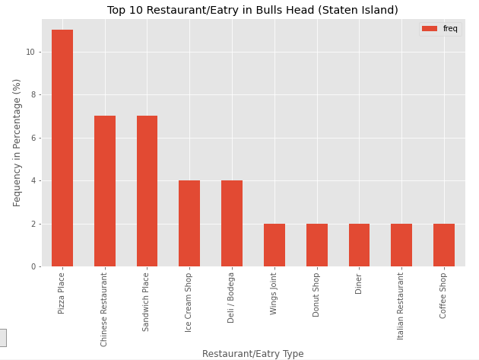
Results continued

Slide 11
Thanks and Regards

